Slide 1
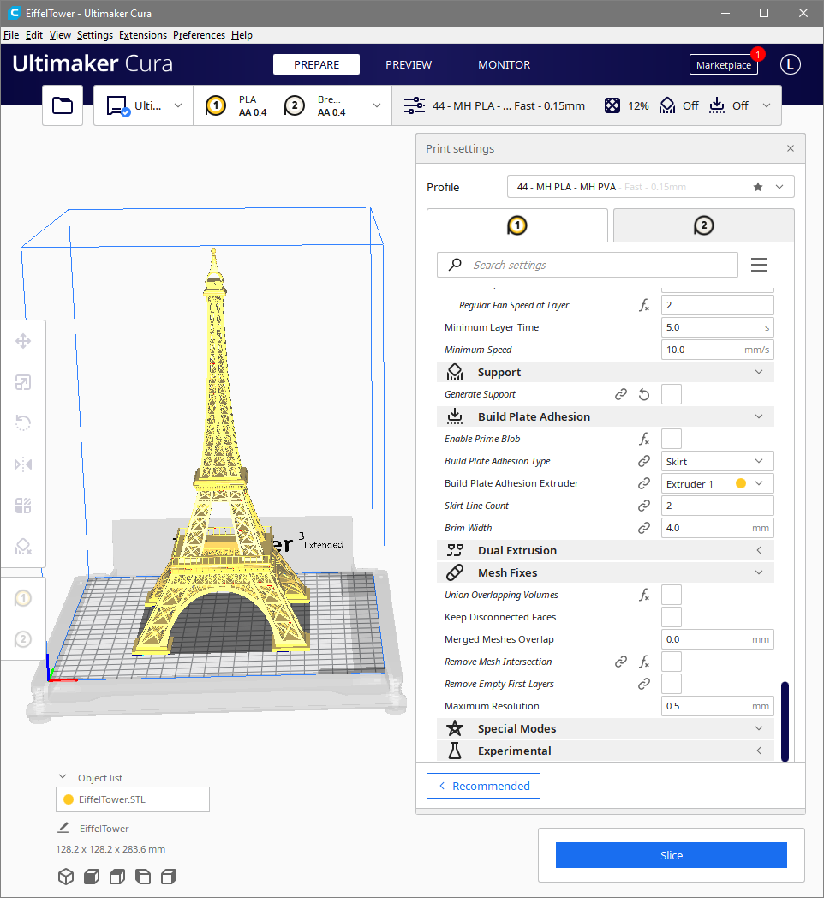
Ultimaker Cura
Profile and User Interface Improvements
Presented by
Lance A. Endres, Ph.D.

Slide 2
Please feel free to interrupt and ask questions.
Ultimaker Cura Profile Discussion

Slide 3
Outline
Background.
Demonstration software.
The problems with profiles.
3 main issues with working with profiles.
Final remakes and wrap up.

Slide 4
Background
A brief introduction to my education and work experiences.
Notes:
The problem we are trying to solve.

Slide 5

Background
Ph.D. and M.S. from UCSD
B.S. from LTU
20 years in Oil and Gas developing engineering software
Computational Mechanics and Dynamics
Physics
Computer science
Software development
25 years of software development
Notes:
I’m not trying to claim I have all the answers. I have a background doing exactly these types of things and I have put significant thought into how I would write the software to solve these problems.

Slide 6
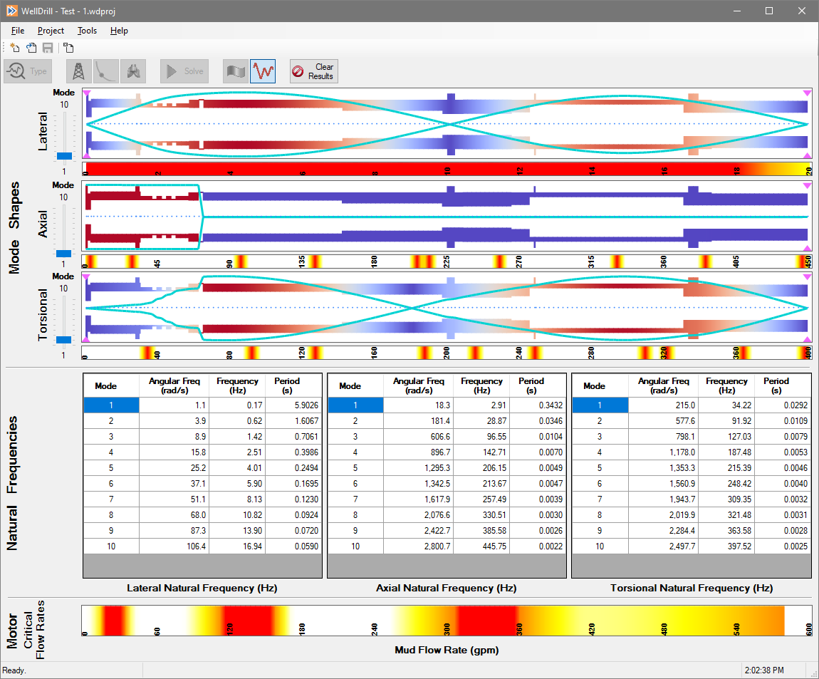
Background
I believe I can provide a unique perspective as an end user and with insider experience.
I realize I am not privy to a lot of the design requirements and considerations.
Notes:
I’m not trying to claim I have all the answers. I have a background doing exactly these types of things and I have put significant thought into how I would write the software to solve these problems.

Slide 7
Demonstration Software
Software has been written to use as a communication tool.
Notes:
The problem we are trying to solve.

Slide 8
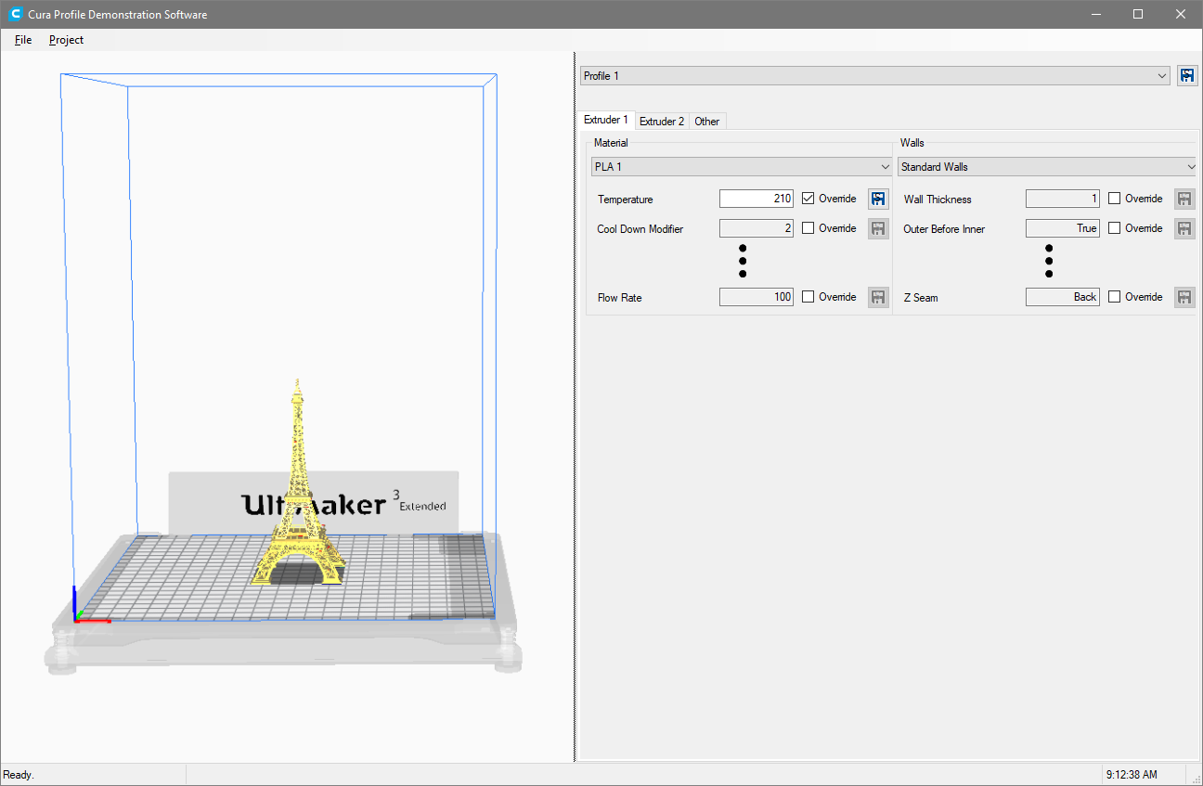
Demonstration Software
Communication tool.
Superficial functionality only.
Not all settings are implemented.
“dot, dot, dot” indicates where more settings would be.
Conceptual in nature.
Notes:
A picture is worth a thousand words.
In this case, it was basically as easy to create a functioning demonstration that it was to piece together static images.
This is just a tool to help with communication, so don’t take it too literally. Just focus on the concepts.

Slide 9
Problem Statement
What makes profiles difficult to work with.
Notes:
The problem we are trying to solve.

Slide 10
Profile Problems
There are 3 main issues with profiles.
The user interface needs more space to work with profiles.
The settings “linked” between extruders need fixed on the user interface.
Profiles are difficult to work with.
Number of settings.
Way that profiles are defined.

Slide 11
Problem 1: Space
More room is needed to work with settings.
Notes:
The problem we are trying to solve.

Slide 12
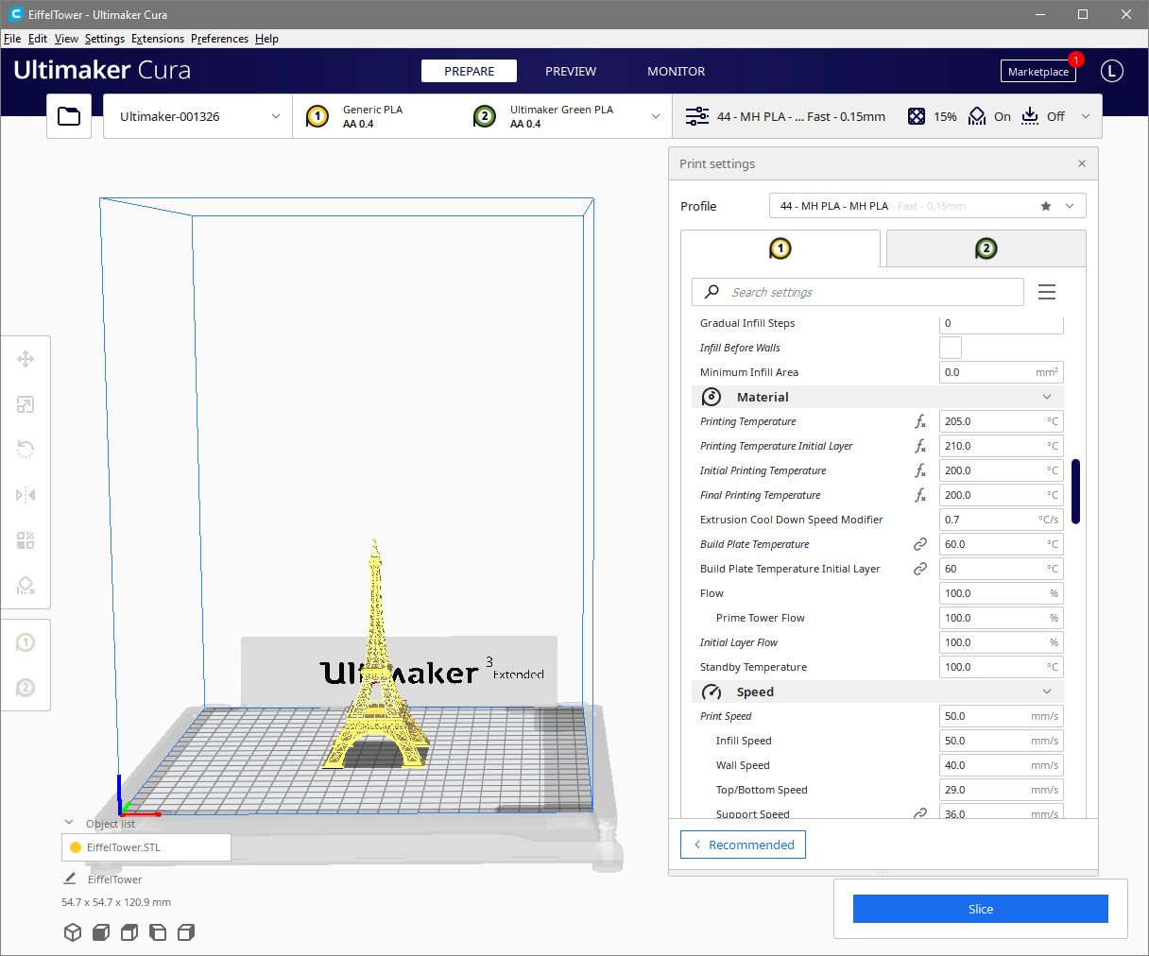
Space
Cura has ~400 settings on each extruder tab.
Space allocated to edit those settings is tiny.
~20 settings.
Constant scrolling to change settings.
More settings have been added.
The space has been shrinking.
Notes:
I interpret a lot of you’re the design changes in Cura as trying to simplify the interface for new users or users who print a lot of the same thing over and over. But those design changes punish the rest of us more experienced users who print a variety of objects where we need to tweak settings to optimize the performance and time to print.

Slide 13
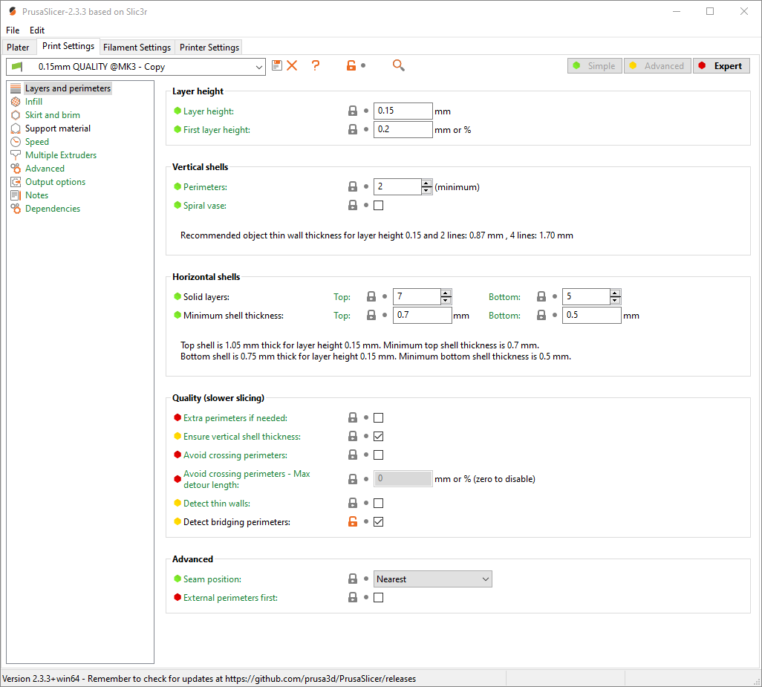
Space
Contrast this to PrusaSlicer
You can use the entire application screen for editing settings.
Notes:
The PrusaSlicer lets you use the entire window to view settings. You can access different sections both horizontally and vertically, which means you aren’t endlessly scrolling through pages to get to a setting.
I’m not suggesting their layout is the best or even something that should be directly emulated, the point here is that there is MUCH more space.

Slide 14
Solution
Add more space
Dock settings control or otherwise correct awkward control hiding floating behavior.
Don’t hide layer control on other side of settings.

Slide 15
Problem 2: “Linked” Settings
“Linked” settings are confusing, redundant, and uneccessary and should be removed.
Notes:
The problem we are trying to solve.

Slide 16
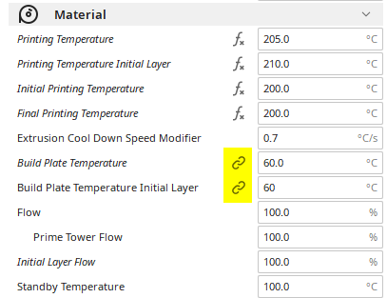
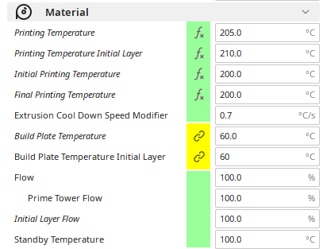
“Linked” Settings
Difficult to understand initially.
It is different from any other user experiences they have had.
Continues to be difficult over time.
“Linked” settings are intermixed with others with only a subtle icon to denote them. Its easy to miss/forget that a setting is linked.
Redundant controls takes up valuable screen real estate.
Notes:
Generally, if you try to create a user interface that is similar to what other software applications use. This make the software much more intuitive. If you are going to do something different from any other user interface experience that exists, you had better have a really, really, really good reason to do so. And in this case, there is not a good reason. This is a consequence of bad design choices.

Slide 17
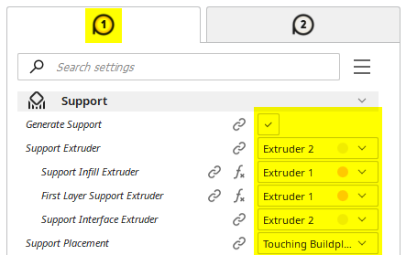
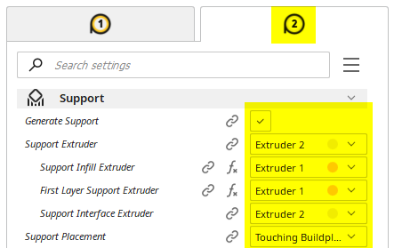
“Linked” Settings
Duplication of controls on User Interface
2 controls for 1 setting is red flag there is a design issue
Non-standard/unique approaches are best avoided

Slide 18
Solution
The solution is straight forward, move all “linked” settings to their own section.

Slide 19
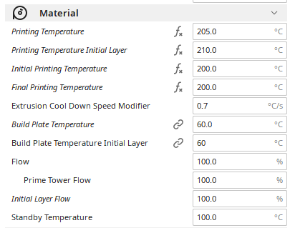
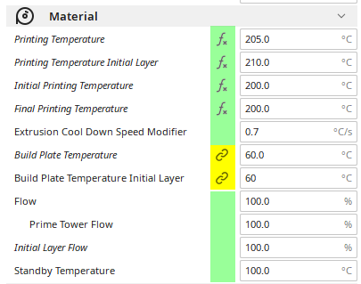
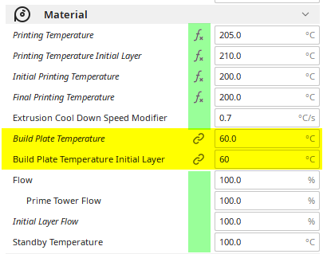
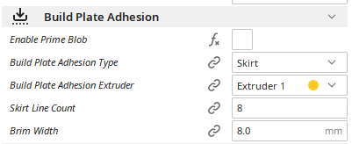
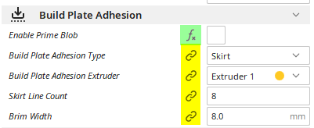
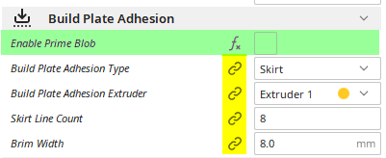
Some Settings Need Moving
Some settings are categorized incorrectly.
They are typically easy to identify.
Categorizing them correctly is typically easy, as well.

Slide 20
Problem 3: Settings Proliferation
Profiles are defined in such a way that it causes the profiles and settings to explode in population and quickly become unmanagable.
Notes:
The problem we are trying to solve.

Slide 21
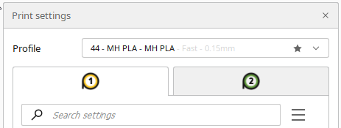
Settings Proliferation
Given the large number of settings and way profiles are defined, maintaining profiles very rapidly becomes a logistical impossibility.
Profile and settings count explosion.
~700 → ~1400
Profile A-B
Profile B-A
Material A
Print Core A
Material B
Print Core B
Material B
Print Core B
Material A
Print Core A
Notes:
Changing a single settings results in a new profile.
This causes the total number of stores settings to multiply very rapidly.

Slide 22
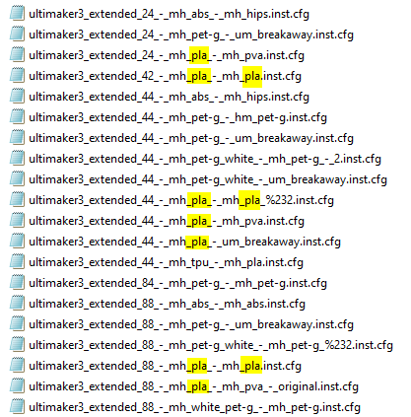
Settings Proliferation
PLA shows up in 10 places.
They are all the same.
90% redundant
Notes:
Those 90 percent of settings are INFORMATIONALLY COMPLETELY USELESS.

Slide 23
Settings Proliferation
Why is this a problem?
Keeping all the profiles synchronized.
Learning a new setting.
New setting added.
Material formula, environment, or machine changes require setting tweak.
Limits usefulness of profiles.
It is not practical to maintain a profile for every permutation of print settings.
PLA, PETG, ABS, et cetera.
With and with out supports.
Single material supports and supports with interface enable.
Permutations of materials and support types.
Permutations of nozzle sizes.
Requires changing 10 profiles
Create profiles for material and then hand edit profiles for each scenario
Notes:
It is not feasible to maintain profiles for each type of printing scenario. It is impractical, unreasonable, and impossible.

Slide 24
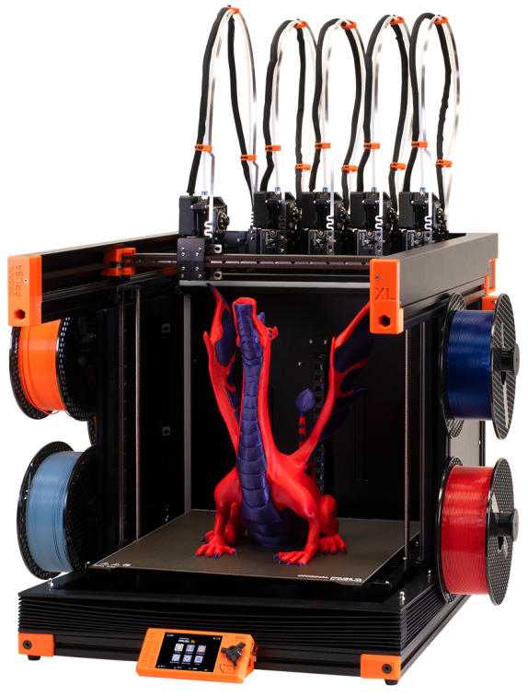
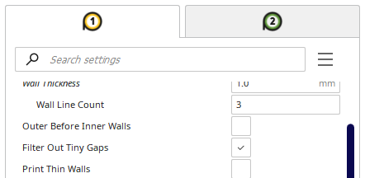
Settings Proliferation
Seems likely more extruders will be supported in the future.
3
4

Slide 25
Solution
Profiles need to be more “reusable” and flexible.
Notes:
A basic example to demonstrate concepts.
A minimum number of settings are incorporated.
Data validation is not complete.
Not intended as “the” solution.
There are many possible valid implementations.
Please focus only on the concepts and learnings.
Take away the Big Picture.

Slide 26
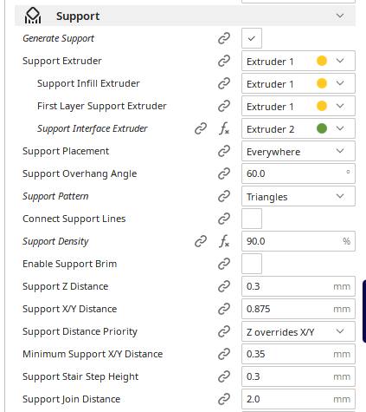
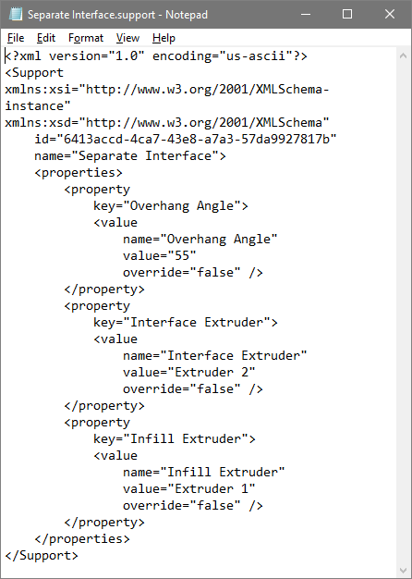
Profile Redefinition
Current definition:
Supports are sub-section of profile.
Solution example:
Supports are a “mini-profile” of their own.
Profiles are diminished in importance. The “mini-profiles” become the dominate way to access settings.

Slide 27
Final Remarks
Notes:
The problem we are trying to solve.

Slide 28
Key Take Aways
User Interface
More room is needed to edit settings. Much more room.
“Linked” Settings
“Linked” settings need to be removed from the “extruder” tabs and into their own sections.
Each “linked” setting should be evaluated to determined its proper section.
Profiles
Profiles need to be more reusable.
One solution is to make each section its own “mini-profile.”

Slide 29
Conclusions
Changes would make the user interface easier to use, cut down on redundancy, and be more logical.
Profiles would be a lot easier to use.
Cut down on profile proliferation.
Less editing of profiles to customize them for each print.
Prepare Cura for the future.
More extruders are inevitable. Without these changes the problems will only multiply.

Slide 30
Organization Changes
This section contains some specific examples of suggested changes.
Notes:
The problem we are trying to solve.

Slide 31
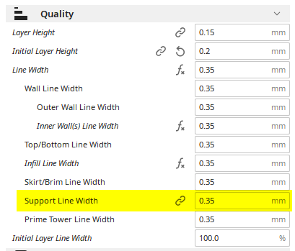
Support Line Width
Support Line Width is the only one of these settings that is “linked” and that is an indication something is wrong.
In this case, the setting is organized in the right place, but its behavior is wrong.
Line widths are more closely associated with nozzle size (extruder).
Each extruder needs its own Support Line Width.

Slide 32
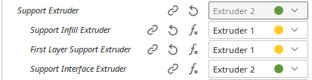
Support Line Width
1
OR
Imagine the case where there is one 0.4 mm nozzle and one 0.8 mm nozzle size loaded.
You have to first select which nozzle is used for support, then go back and set the support line width. This is awkward and unnecessary.
How is case of support interface versus support infill handled? One of the nozzles is going to be printing with the wrong Support Line Width for its size.
2

